Slide 1

Evolution of Cyber Warfare: Combined Arms in the Information Age
Seger Steele
Staff Security Engineer
Notes:
Hey everyone! How we feeling? Awesome. Thanks for making the time to be here today.
Today were going to cover the evolution of cyber warfare, how it fits into modern combined arms and some predications for the near future of cyber warfare.

Slide 2



Do not edit How to change the design
Join at slido.com #23541026
The Slido app must be installed on every computer you’re presenting from
Notes:
We’ll be using Slido today to make this presentation more interactive, throughout the presentation there will be parts where your input from your device will be displayed on the slides
Simply scan the QR code or use the join code to join our session – I promise the QR code is safe to scan lol
We’re gonna stay here for a bit longer to allow everyone time to join
While we wait, I skipped the classic whoami slide for this presentation to focus more on the content. The quick stuff is I’m Seger Steele - a Security Engineer with Arcadia; a SaaS analytics provider & coming up on 7 years of experience in Security. I am not in the military, nor have I ever been – but I'm passionate and curious about modern conflicts, and even more so about the conflicts of the future which lead me to the months long research for this presentation!

Slide 3

Do not edit How to change the design
What comes to mind when you hear 'cyber warfare'?
The Slido app must be installed on every computer you’re presenting from
Notes:
To get us kicked off, we'll start with a word cloud! On your end in Slido, spell out what comes to your mind when you think of cyber warfare!
We'll give roughly 30 seconds to make sure people have time to fire off responses

Slide 4

Introduction – The New Battleground
Cyber Meets Kinetic
Combined Arms refers to the coordination of several military domains to complement each other and increase combat effectiveness.
Cyber warfare simply refers to hacking/digital attacks with the goal of causing harm, disruption, or destruction
Not just Sci-fi
Several recent and notable examples of the cyber domain becoming increasingly critical in modern conflicts.
Why it matters
Any modern conflict between major powers will include heavy use of the cyber domain.
Notes:
Quick show of hands, who is aware of what combined arms is?
Combined arms historically is a military doctrine that dictates units and even separate domains should complement each other to increase how effective they are. A simple example being, infantry can knock out Anti Air guns, so jets can bomb adversaries engaging the infantry.
Cyber warfare is given a simple definition here, mainly digital attacks with the goal of causing harm, drisurption or destruction and we will cover a ton of examples today
What used to be science fiction is now a reality. A reality that’s arguably changing faster than a lot of countries and organizations are prepared for.
This will be mostly informative and higher level – the theme Im looking to drive home is the next major conflict between superpowers on earth will have a unprecedented use of the cyber domain

Slide 5

A Brief History of Cyber Warfare (2007-2012)
Estonia
For 22 days, DDoS crippled public and private sector websites included forced service shutdowns
Approx $750 Million in damages
Stuxnet
Widely recognized as most famous case of physical damage caused by code
Sabotaged Iran’s uranium centrifuges, destroying about 20% of their centrifuges
2007
2010
2008
2012
Russia-Georgia 5 Day War
DDoS/scanning for weeks leading up to Russia’s invasion
Mass defacement of Georgia government sites, as well as Russian & Azerbaijani media outlets
Shamoom
Targeted Saudi Aramco, infecting over 30k windows computers within their corporate network
Rendered over 75% of corporate PCs unusable, notably oil production was not impacted due to ICS not being impacted
Notes:
Lets start with Estonia – For 22 days, 2 million bots from 175+ countries pounded Estonian government and public sectors with DDoS attacks. This resulted in approximately 750 million in damages. Attributed to Russia pro-kremlin youth group, but of course Russia denied involvement
Next up is the Russia/Georgia 5 day war. Not a day of the war went by without DDoS/Defacement. Defacement examples include Ministry of Foreign affairs website depicting 20th century dictators including Hitler. This is the 1st novel example of cyber domain being included in combined arms doctrine as this was ongoing before and during the kinetic conflict.
Now Stuxnet, Most people here are probably familiar with Stuxnet so I wont spend too much time on it. This is recognized as the most famous case of physical damage caused by code. The malware ended up destroying about 20% of Iran’s uranium centrifuges. While widely attributed to a collaborative effort between the United States and Israel , specifically the NSA/CIA and Unit 8200 – both countries denied involvement.
2 years later, a Iranian attributed malware named Shamoom struck the Saudi oil titan Saudi Aramco. Here we have a example of critical energy being targeted successfully. While this malware has evolved since its first variant, it can be simplified to say it was a data wiper that also dropped images of a burning American flag. I did try to find the image as it was confirmed to be present in some forensic reports but couldn’t locate the actual image used by the original malware.

Slide 6
Cyberattacks join Russia’s Arsenal (2015-2017)
Ukraine Power Grid
Russia-linked hackers (Sandworm) tripped circuit breakers at 30 substations, causing a ~6 hour blackout
1st known blackout from cyberattack
NotPetya
Sandworm deploys devastating ransomware that racked up over $10 Billion in estimated financial damages.
Initially targeted Ukraine, it ”spilled over” globally impacting logistic giants like Maersk and FedEx amongst many others
2015
2017
2016
Kyiv Transmission Station
Another Russian backed attack hit a Kyiv Transmission station, causing another blackout in the Capital
Notes:
Lets fast forward our timeline.
Well start in 2015 – One of the intelligence agencies of Russia, referred to as the GRU are behind our first attack on this slide. GRU focuses on both intelligence gathering as well as military operations, including the Spetnaz and a cyber espionage group referred to as Sandworm. In what is known as the 1st blackout from a cyber attack, Sandworm tripped circuit breakers at over 30 substations triggered a ~6 hour blackout in Ukraine.
The following year in 2016 – Another cyber attack on Ukraine’s energy grid occurred when a transmission station in the capital of Kyiv was brought offline, resulting in a shorter blackout period. While not attributed to a single group, but rather a coalition of groups – Sandworm is included in the coalition.
One year later in 2017 – a ransomware variant called NotPetya began encrypting and disabling operations for the Ukraine government and private sector, including port operators in vital cities like Odessa. Given the self replicating nature of NotPetya, it eventually spread to beyond Ukraine to 60 countries, infecting thousands of businesses and causing over $10 Billion in damages world wide according to some estimates.

Slide 7
Case Study – Ukraine and Russia: A Hybrid War
Combined Arms in Action
Hours before the Feb 24th invasion, Russia launched coordinated cyber attacks to sow confusion and soften targets.
Viasat’s KA-SAT satellite internet network across Ukraine was took down, also “spilling over” again to central Europe disrupting wind turbine operations.
Data-wiper malware hit Ukrainian government agencies, banks and transport network.
Critical Infra at Risk
Cyber attacks on Ukraine’s powergrid are regular now but are also combined with kinetic strikes from Russian missiles or more recently, Iranian provided Shahed drones. This underlines that one way or another, infrastructure will be targeted.
Defenders go Digital
Ukraine mobilized the IT Army of Ukraine – a global coalition of IT specialists that perform offensive and psychological operations against Russia targets.
DISCLAIMER: Hacking, even on behalf of an ally, is within purview of the Computer Fraud and Abuse Act (CFAA) and is subject to civil and criminal penalties under law.
Notes:
Mere hours before the invasion of Ukraine in Feb of 2022, numerous cyberattacks were executed against civilian and military targets.
Viasat, which provided satellite internet to Ukraine was forced offline, and again we “spill over” with the internet outage also effecting central European wind turbine operations, hitting energy supplies of Ukraine backers.
Data-wiper malware also infected numerous government entities, along with banks and logistics in the country. This again is the concept of combined arms integrating the cyber domain.
Throughout the war, cyberattacks on Ukraine’s energy infrastructure and powergrid have become a regular occurrence. Russia regularly uses bombs/missiles and drones to target the grid – underlining that critical infrastructure during war will be targeted, either through kinetic weapons or cyber ones.
An interesting initiative launched by Ukraine to crowdsource help with offensive and psychological operations called IT Army of Ukraine just 2 days after the start of the Russia invasion.
They allow citizens from any country to join while providing Russia targets and are provided prepacked DDoS kits for one example. When I first investigated this about a year ago I joined the telegram they were using to coordinate with volunteers just to see what their messaging looked like – I didn’t help attack Russian assets to be clear.
Lastly we have a legal disclaimer to cover my ass - if you're curious looking into this – remember you are subject to both criminal and civil penalties for breaching the computer fraud and abuse act.

Slide 8

Do not edit How to change the design
Trivia! The phrase “Cyber Warfare” was first coined by Wired magazine in what year?
The Slido app must be installed on every computer you’re presenting from
Notes:
Alright for our next Slido slide well do some trivia!
What year was the term "cyber warfare" first coined?
We'll give about 15 seconds before showing the response.

Slide 9
Information Warfare – Demotivate the opposition
Vietnam War – Hanoi Hannah
Radio broadcasts targeting US troops, up to 90 minutes daily.
List U.S. casualties, reported anti-war protests from the U.S. & played anti-war music.
Russian Bot Farms
Meliorater: Create/coordinate over 1,000 bot accounts on Western social media platforms.
Ukraine Invasion - Zelenskyy Deepfake
Weeks after the invasion, a video of Zelenskyy ordering troops to stand down spread across compromised news sites and social media. (i.e. Telegram)
Notes:
Many of us have either parents, grandparents or family friends that served in Vietnam. They likely heard Hanoi Hannahs voice.
She was broadcasted from speakers in the forest for around 90 minutes daily, reading US casualties, anti war news from the US including protests and played anti war music.
Fast forwarding we have bot farms. Most of know what social media bots are – Russia has a platform called Meliorater that can create coordinate thousands of bots across western social media sites like youtube, X, Instagram, etc.
An example would be a bot posting a pro Russia theme, such as saying the US should cut military aid to Ukraine – and then other bot accounts will bolster this tweet by giving it retweets or whatever its called now – I don’t use X lol To conclude well speak on the Zelenskyy deepfake. 3 weeks after Russia began the invasion – a deepfake video of Ukraine's President Zelenskyy circulated around demanding that troops lay down arms. This circulated on Telegram along with a legit Ukraine news website that Russia compromised.
For those that didn’t see it I embedded in this video

Slide 10
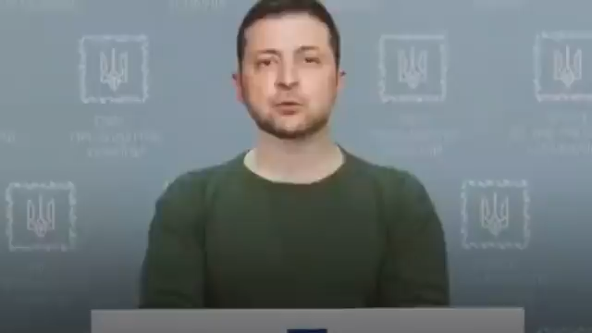
Notes:
Mention this was less than a month after the war started, was uploaded to a hacked Ukrainian news site and spread on social media like Telegram.
Mention its bad quality, but when this came out, we were still getting the videos of Will Smith trying to eat spaghetti and tweaking the hell out. If we used the deepfake tech we have today, this would be have much more convincing.
Months after this, reports emerged that Russia was intending to erode confidence in Ukrainian media, convincing troops to stand down was just a bonus

Slide 11

Drones – The New Equalizer
Drone Revolution
Innovation on the fly
The advent and rapid adoption of unmanned drones represents a clear fusion of tech with warfare
They depend on potentially vulnerable tech like GPS, sensors, communications components, etc
Drone mass production in full force, with Ukraine producing 4 million drones annually in 2024
Wartime urgency has shortened the R&D cycle - adding AI capabilities, better sensors and introducing and improving how enemy drones are targeted
Cost comparisons are no brainers - destroying a tank with a Javelin missile costs on the lower end 178k, while a kamikaze drone can cost at the highest end 1k
Notes:
Let’s take a slight detour to talk about drones.
Wmilitaries have been fielding piloted drones like FPV drones and loitering munitions that patrol a area for targets – drones that can navigate and engage enemies on their own are becoming more common in Ukraine
Drones depend on various tech components - including for navigation like GPS and internet connectivity, communication and various sensors for situational awareness.
Both sides in the conflict are using a record amount of drones on the battlefield, with Ukraine producing 4 million drones annually.
Wartime urgency has rapidly shrunk the R&D cycle. Leading to drones with better sensors, more autonomous capabilities built with AI and more effective counter measures to target drones.
Drones will be become increasingly important. While this sounds obvious out loud, lets look at the cost comparison.
Javelin Anti-Tank rockets cost on the lower end 178k to fire a single round. Compare that to a single kamikaze drone piloted by a human, which costs on the higher end 1 thousand, including a payload. You can swarm a tank or column of tanks with 20 drones to ensure the target is hit and you save a enormous amount of money.
Why do we care? Drones have become a target of electronic warfare which we will get into shortly. Before that I want to share something else.

Slide 12

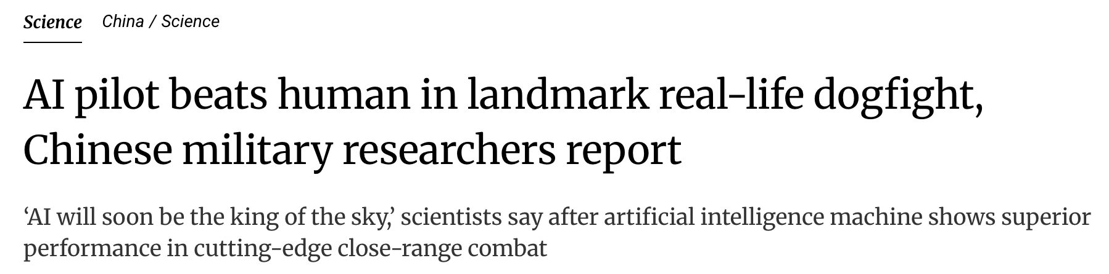
Notes:
The top headline is from DefenseOne.com – the short version is a fully AI piloted fighter jet, using a modified F-16 took on a human pilot at Edwards Air Force base.
While the win/loss ratio wasn’t disclosed for national security reasons, the program wasn’t cancelled and more plans were laid out to get these aircraft fighting beside human pilot fighters, which I take as them seeing good results.
Additionally, the bottom headline shows China also conducted AI vs Human pilot dog fights, and they reveal the AI had beat human pilots more often than anticipated.
A interesting bit I found while digging more on this, is that militaries are planning on having AI wingman, where AI fighter jets or drones will fight alongside humans, provide call outs – and if needed, sacrifice their own vehicle to protect the human pilot.

Slide 13

Notes:
Staying on drones we can see a report from Reuters about 2 weeks ago highlighted that Chinese models like DeepSeek and Qwen are already integrated into warfighter robot dogs and drone swarms for target acquisition and real time battlefield analysis.

Slide 14
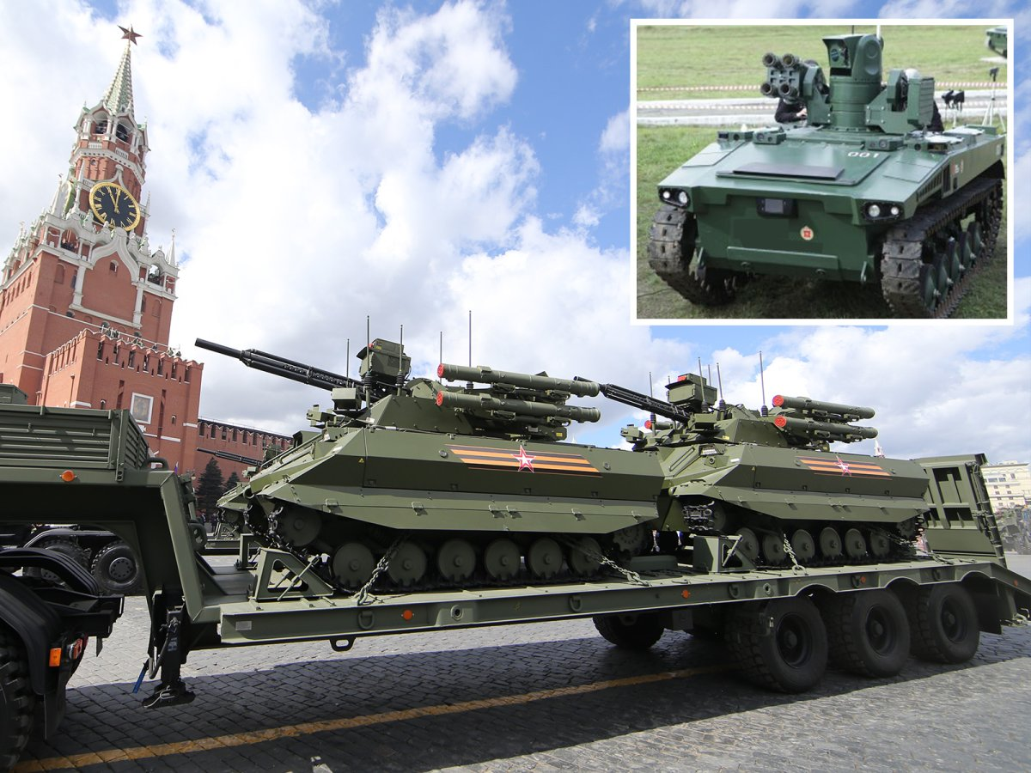
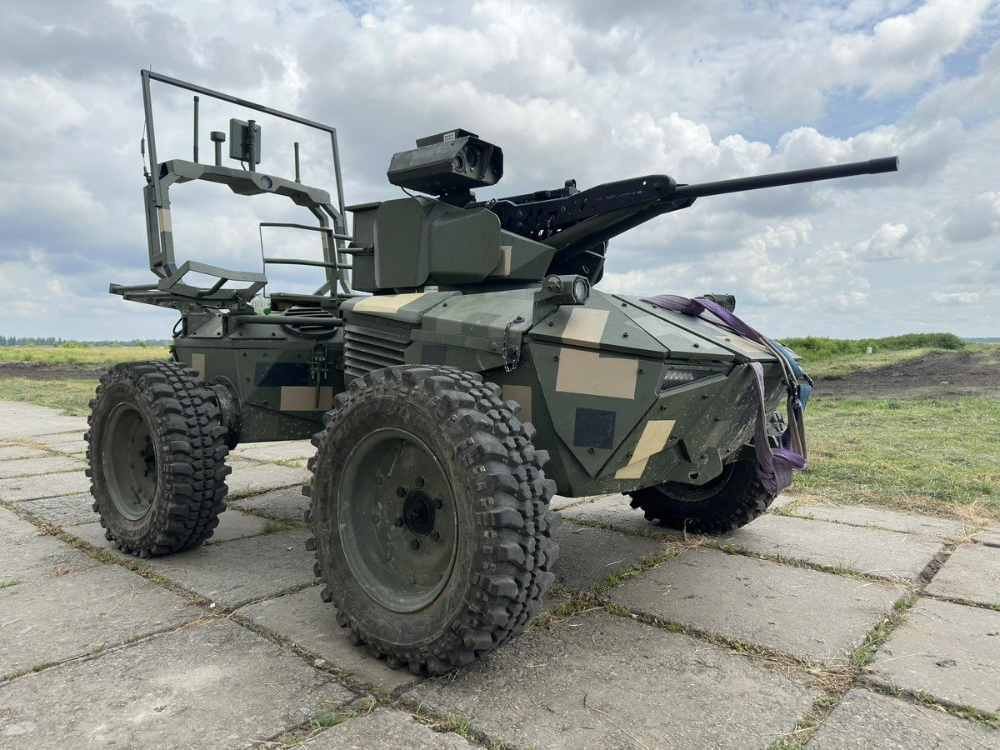
Notes:
Here you will see a collection of unmanned ground vehicles or UGVs. On the top left is a Ukrainian one and the in the center and right are Russia models. While the Ukrainian model pictured is fully remote controlled by a human operator, the Russian models presented are using AI as an “enabler”, assisting with enhanced computer vision and target acquisition
While UGVs have been subject to Electronic Warfare on the frontlines, how long until we see the command-and-control link can be hijacked, and the vehicle turns on its allies? Or compromising the locally deployed AI on the Russian models to do the same? These questions are being asked about the drones in use today.

Slide 15
Electronic Warfare – Invisible Battles
What is Electronic Warfare(EW)?
Notable EW advancements
Jamming, spoofing and intercepting signals to blind the enemy while protecting your own.
Aims to disable the “nervous system” (radios, GPS, radar, wireless links, etc) of weapon platforms.
Ukraine’s Ghost Dragon drone uses onboard AI/Computer vision (CV) to withstand intense jamming on the frontlines.
Russian EW platforms like Leer-3 can jam UAV control links, and spoof cell towers to send fake SMS messages.
Anduril produces the Pulsar-L platform which can disable whole swarms of unmanned drones.
Notes:
The most interesting way is via Electronic warfare.
EW refers in general jamming, spoofing and intercepting signals l Aims to disable the “nervous system” of electronic weapons that help them think and navigate like radios, GPS, radar etc.
Notable EW Advancements
So lets discuss some notable advancements made recently in EW.
We will start with how Ukraine is resisting EW attacks – they use drones that run AI models locally combined with computer vision to withstand these attacks. Speaking of resisting EW attacks, both sides use spindles of fiber optic cable that allows drones to be hardwired to their command and control console.
Then we have Russian platforms like the Leer-3 that jam UAV control links and can also spoof cell towers, sending fake SMS messages to front line soldiers to demoralize them
Lastly, an American defense start-up named Andruil produces the Pulsar-L platform which can disable entire swarms of unmanned, autonomous drones. The kicker is the platform weighs less than 25 lbs and takes only 2 minutes to set up so its very portable

Slide 16
Cyber and Kinetic Combined – Tactics in Action
Softening the Battlefield
We witnessed Russia cause internet and energy blackouts during the opening hours of their invasion.
Israels Infamous Pagers
In September 2024, 1000’s of pagers that Hamas operatives used were detonated
Hamas purchased the pagers through a shell company that was stood up by Mossad, an Israeli intelligence unit.
Kinetic Strikes on Digital Targets
In 2019, one of the first known kinetic attacks on a cyber unit occurred when Israel airstriked a building that housed Hamas cyber operatives.
Hypothetical Scenario
Imagine prior to a military base being attacked, the air defense network is taken offline – leaving it vulnerable to kinetic weapons.
Notes:
Lets drive home combined arms
We touched on this earlier, just restating here for emphasis.
Israels infamous pagers
Raise your hand if you remember hearing about the pagers detonating?
The short version is Hamas was purchasing pagers to avoid spying from Mossad, a Israeli intelligence agency. What Hamas did not know, was the company they purchased those pagers through was actually a Mossad shell company.
Isreal had placed PETN explosives in each pager, and once they were ready to attack – they sent a encrypted message spoofing Hamas command to the pagers – causing the detonation
Something we haven't discussed is kinetic attacks on cyber targets. Has that happened?
It has – in 2019 Israel airstriked a building housing Hamas cyber operatives – showing cyber operatives can poise enough of a threat to be targeted outright with kinetic weapons
Hypothetical Scenario
Imagine prior to a military base being attacked, the air defense network protecting is taken offline by a cyber exploit – leaving it vulnerable to kinetic weapons. This is a scenario we could expect to see in conflict within the next decade or 2.

Slide 17



Bleeding-Edge Tech – The Next Frontier
AI on the Battlefield
Expanding Targets
Space
Militaries are exploring using fully autonomous drone swarms to overwhelm defenders
Can we find a exploit to gain control of the swarm?
Augmented Reality Visors are in development, like the EagleEye system by US start up Anduril
Robots are in service today for multiple militaries, such as quad pedal ”dog” robots or UGVs
Future use cases include sat images being doctored, redirecting GPS guided weapons and forcing sats to crash
Notes:
AI on the battlefield – more than just a buzzword
Militaries today are exploring fully autonomous drone swarms, ranging from a less than 10 to hundreds of drones being coordinated with AI.
If you put on your black hat, how could we exploit these to gain control of the swarm and assign new targets or make the drones land?
Augmented Reality Visors are being developed and are in use in small numbers today by the US military. These visors provide waypoints, real time maps of enemy and friendly forces, enhances target acquisition and more. What if these visors could be exploited to feed false information to soldiers?
The scariest one on this list is robots. Many militaries today use robots for support roles like evacuating injured soldiers or mine sweeping. We’ve also observed quad pedal, think of the dog robots, having mounted guns and flamethrowers. This is self explanatory why you would want to compromise these.
And then there is Space
Theres tons of use cases here, but some of the ones I find more realistic are doctoring satellite images to conceal troop movements. Theres also the question if we redirect GPS guided weapons like ballistic missiles to our own provided set of coordinates. Most modern satellites include navigation controls, what if we could force enemy satellites to crash into each other or crash down to Earth?

Slide 18
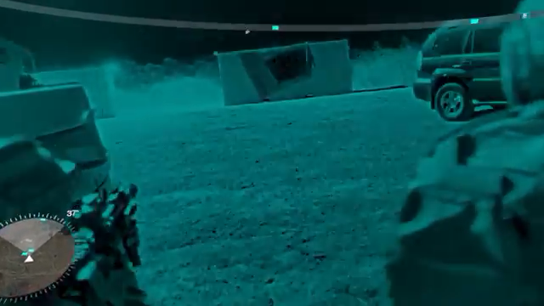
Notes:
Now here we quick demo of the EagleEye platform that’s in use today.

Slide 19
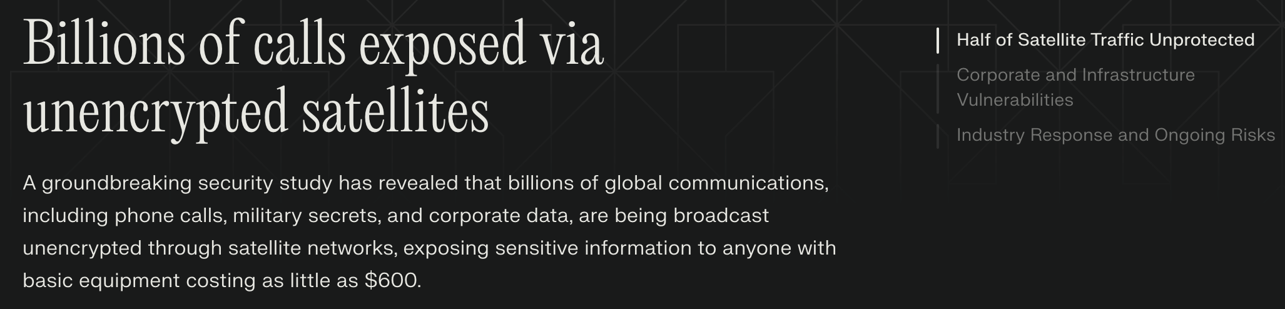

Notes:
On Tuesday a research paper was released showing that about 50% of satellite communications are unencrypted. The paper is titled Don’t Look Up as a reference to how many satellites didn’t consider adversaries looking at satellite traffic
The intercepted data included thousands of T-Mobile users' phone calls and text messages, unencrypted internet communications from US military vessels, along with detailed Mexican military and law enforcement tracking data for helicopters, naval vessels, and armored vehicles

Slide 20
Do not edit How to change the design
Final Trivia! How many months did it take the US Military to complete Operation Buckshot Yankee - a Incident Response of compromised classified networks attributed to Russia?
The Slido app must be installed on every computer you’re presenting from

Slide 21
Closing Thoughts
Key Takeaway: Until a war between great powers occurs the full impact of cyber warfare is unknown. As the cyber domain becomes more incorporated into combined arms strategies, expect exciting innovations in this area.
Professional Responsibility: Security is a thankless job, but its vital. Take pride in your work!
Notes:
To circle back, cyber warfare is here to stay – and we’ve seen the capabilities of some coordination to include the cyber domain. As time goes on only expect this to be adopted more rapidly which full further spur the innovations in this area.
And one last note to close out – Security is a thankless job. Much of our work goes unnoticed and that is just part of the gig, right? But our jobs protect other organizations and, for many, an extension of defending the United States. Take pride in your work!

Slide 22
Q/A Session
Notes:
We've come to the end of our session, we have time for Q/A so if anyone has questions feel free to raise your hand!
Alright, I'll stick around for a bit if anyone wants to discuss anything 1 on 1

